Slide 1
Project Documentation

Slide 2
Content
Ask Question
Collection & Exploring
Engaging the audience
Visual aids
Final tips & takeaways

Slide 3
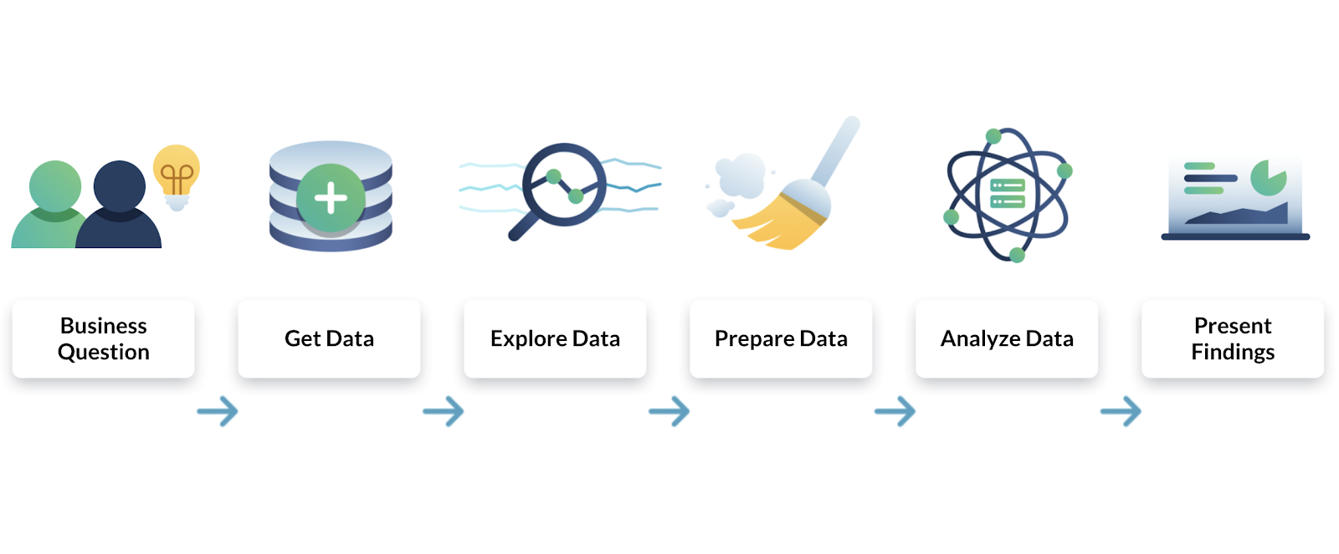
Analysis Procedure

Slide 4
Ask Question
Targeted Audience : Middle management
Stakeholder Needs :
Sales , Profit and Cost across all chain’s Store , Products , Category .
Business Nature: Super Market chain with 100 Stores overall 10 Country.

Slide 5
Collection & Exploring
By Exploring Data we found the following :
Missing Data : Only had record for one day of May
Blank Data : Blank Cells Excel : =Count Blank cells
Illogical data :
:Profit was illogical High compared with revenue As profit was 2.8 Million ,while Reveune 5.3 Million , while Cost was represent ( 0.15 Million ) 3 % out of Revenue which it’s illogical , we found that there was cost element that weren’t added ( Power [include cost of electricity – gas – water ] also the infrastructure cost [include Machines – Tools – water ] and other factors of cost.. The cost which has been calculated focused on material consumption
Product_Name | Category | Inventory_Level | Unit_Sold_per_transaction
290 | 10 | 1 | 10

Slide 6
Cleaning & Preparing
Missing Data : removed Record of 1 May as the month isn’t completed
Blank Data : Fill has many cell empty especially in Country name & Category
Using Excel :
Country name were missing in some records, we used Store ID via “VlookUp formula”
Category were missing in some records, we used Product_Name via “VlookUp formula”
Using Python : 10 cell empty unit sold per transaction & 1 cell inventory level , since these count of cells has minor impact compared with the other records count we decided to drop
import pandas as pd
df = pd.read_csv('/content/Uncleaned Data.csv')
df.isnull().sum()
df.dropna(inplace = True)
df.info()
df.describe()

Slide 7
Cleaning & Preparing
Normalization : we had only one table we’ve decided to separate this fact table into 3 tables main – Product info – Store Info
Product info including (Product Code / Product Name /Category)
Store Info (Store ID / Country/City)
Flag (Flag URL/ Country)
*Columns names that shall be removed from fact table to subsidiary tables

Slide 8
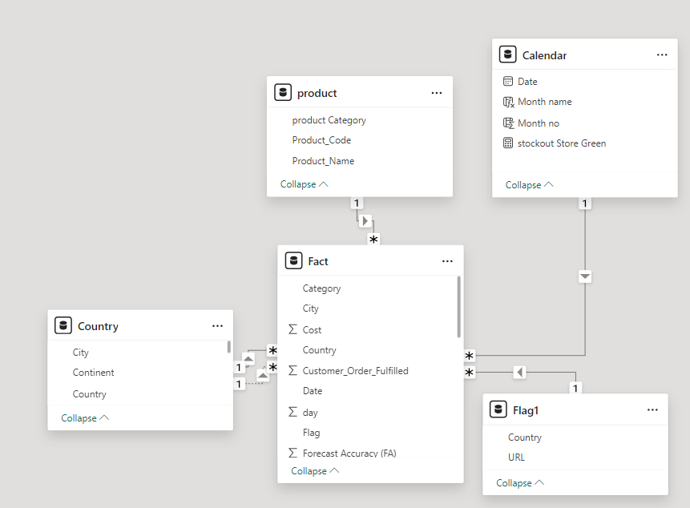
Data Modeling

Slide 9
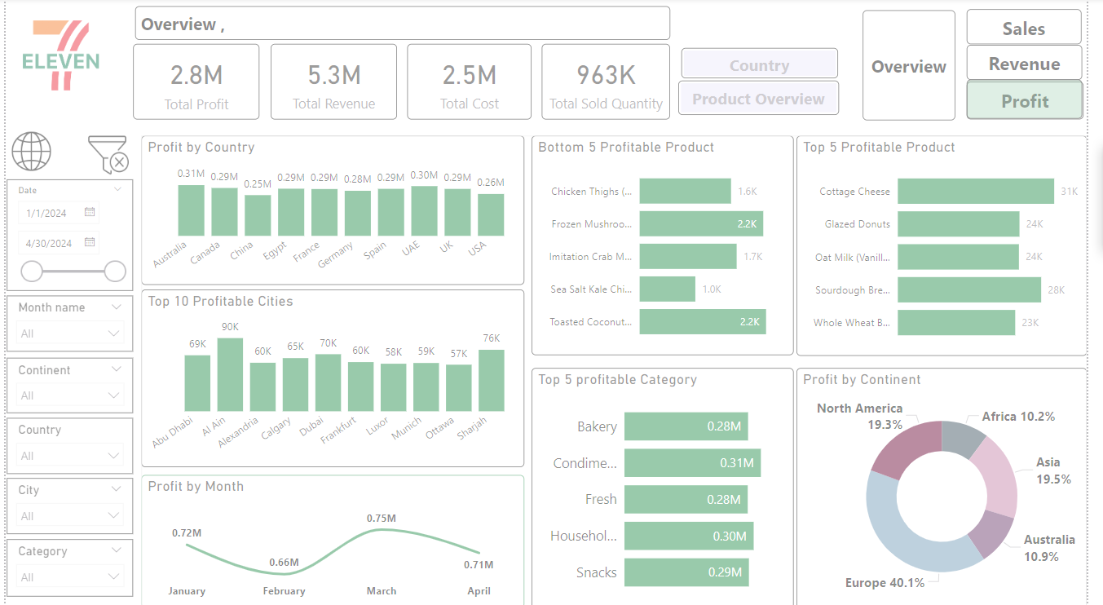
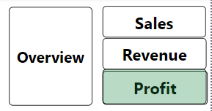

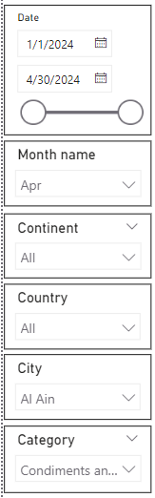
Dashboard
Dynamic Title with Filtered item
Drill- Through
Bookmarks
Clear -Filters
Page - Navigator
Filters

Slide 10
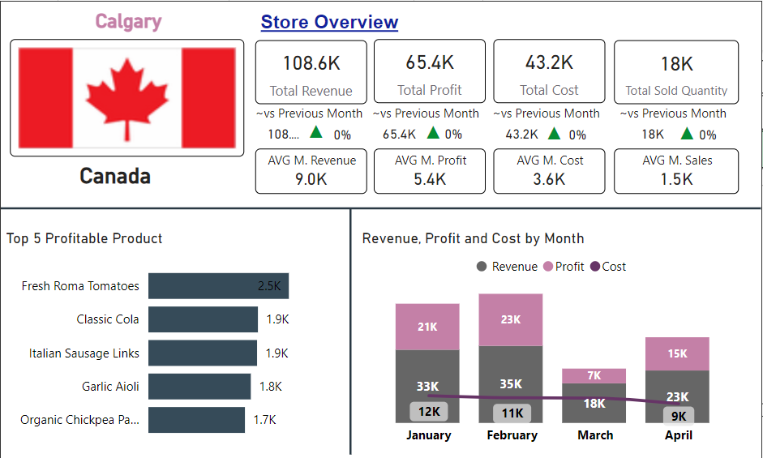
ToolTip
Dashboard
Elaborating Store Info Total , Average , MOM% of sales , profit Revenue , Cost …Etc
ToolTip

Slide 11
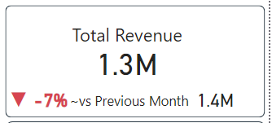
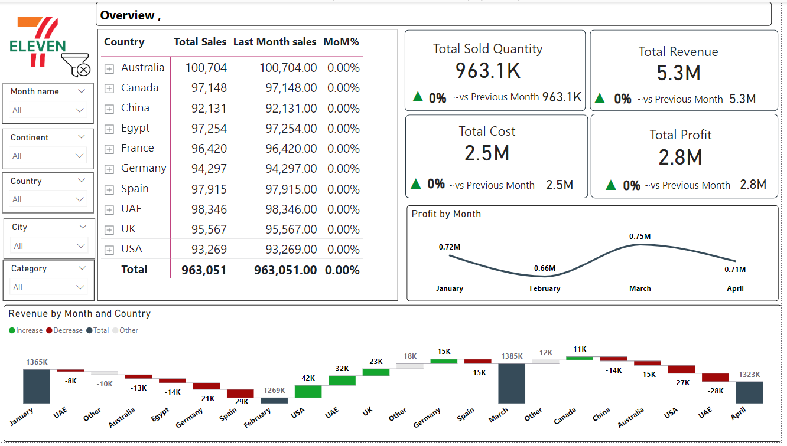
Dashboard
MOM %
Last Month total
At a glance View
High Level Insights

Slide 12
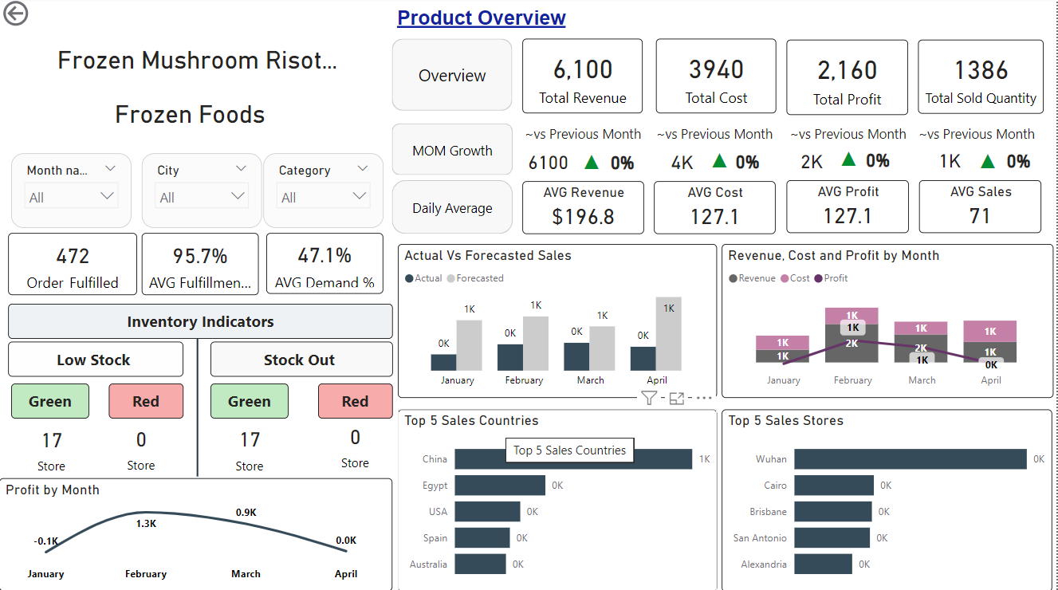
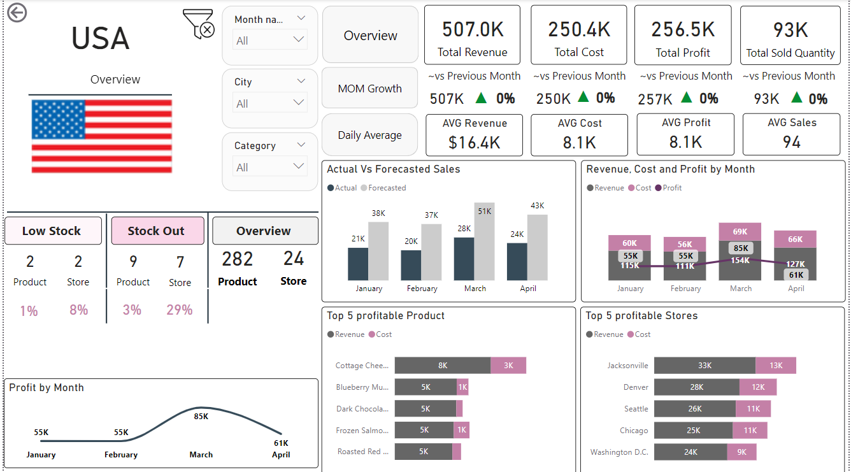
Dashboard
Drill Through Pages
In-Depth details regarding Country & product

Slide 13
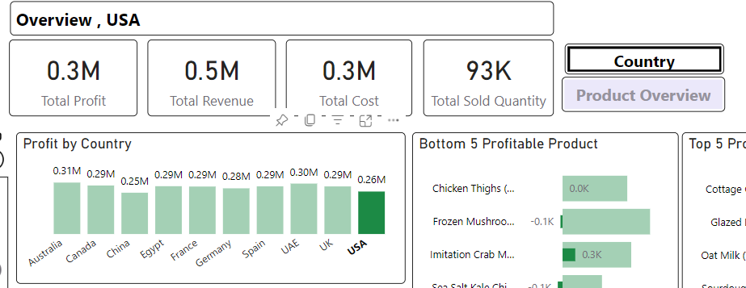
Dashboard
Drill Through Pages
By Selecting Country
Button color change , then click it to be directed to Country page
In-Depth details regarding Country & product
Same for Product by selecting Product Button color change , then click it to be directed to Product page

Slide 14
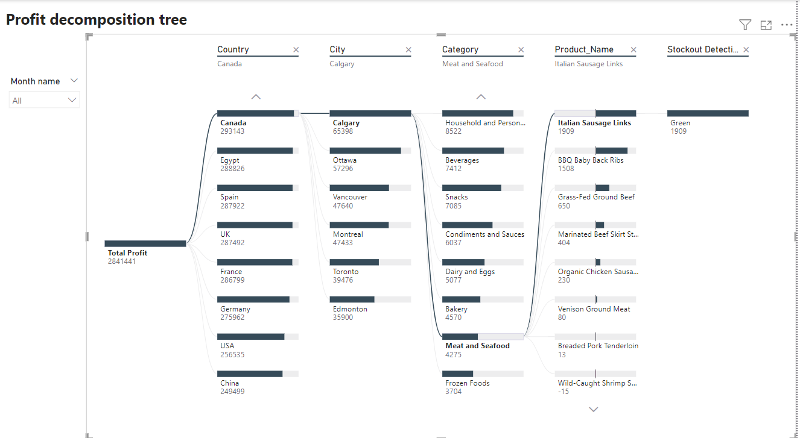
Dashboard
Profit decomposition tree

Slide 15
Analysis & Visualization
This Part elaborated explicitly on the main presentation
High Level Analysis & insights (using Excel &Power point)
*Double click here

Slide 16
Thank you

